Slide 1

Text-Based Emotion Detection for Cybercrime Investigation
Submited By : Lovenesh Sharma
MCA Section -D
(A010145024236)

Slide 2
INTRODUCTION
Cybercrime is increasing rapidly due to the growth of the internet and online communication platforms. Activities such as online threats, cyberbullying, hate speech, phishing, and harassment are commonly performed through chats, emails, and social media messages. These text messages act as important digital evidence during cybercrime investigations.
Problem in Traditional Forensic Systems :- Traditional forensic investigation systems mainly focus on technical details such as IP addresses, timestamps, device logs, and network records. Although these methods are useful for identifying suspicious activities, they often ignore the emotional intent hidden inside communication. As a result, investigators may miss important behavioral clues while analyzing digital evidence.

Slide 3
Objective
The main objective of this project is to develop a text-based emotion and threat detection system that can support cybercrime investigation using Natural Language Processing (NLP) and Machine Learning techniques.
Emotion Detection: Analyze text messages, emails, chats, and social media posts to identify emotions such as anger, fear, joy, sadness, threat, and neutral.
Ensemble Learning: Combine Logistic Regression, Random Forest, and SVM using a Soft Voting Ensemble approach to improve prediction accuracy and reliability.
Text Processing: Use Natural Language Processing (NLP) and TF-IDF feature extraction to clean textual data and convert it into meaningful numerical features.

Slide 4
Dataset description
The proposed framework uses two open-source datasets:
Wikipedia Detox Project Dataset
Foundational Emotion Dataset (eng_dataset.csv)

Slide 5
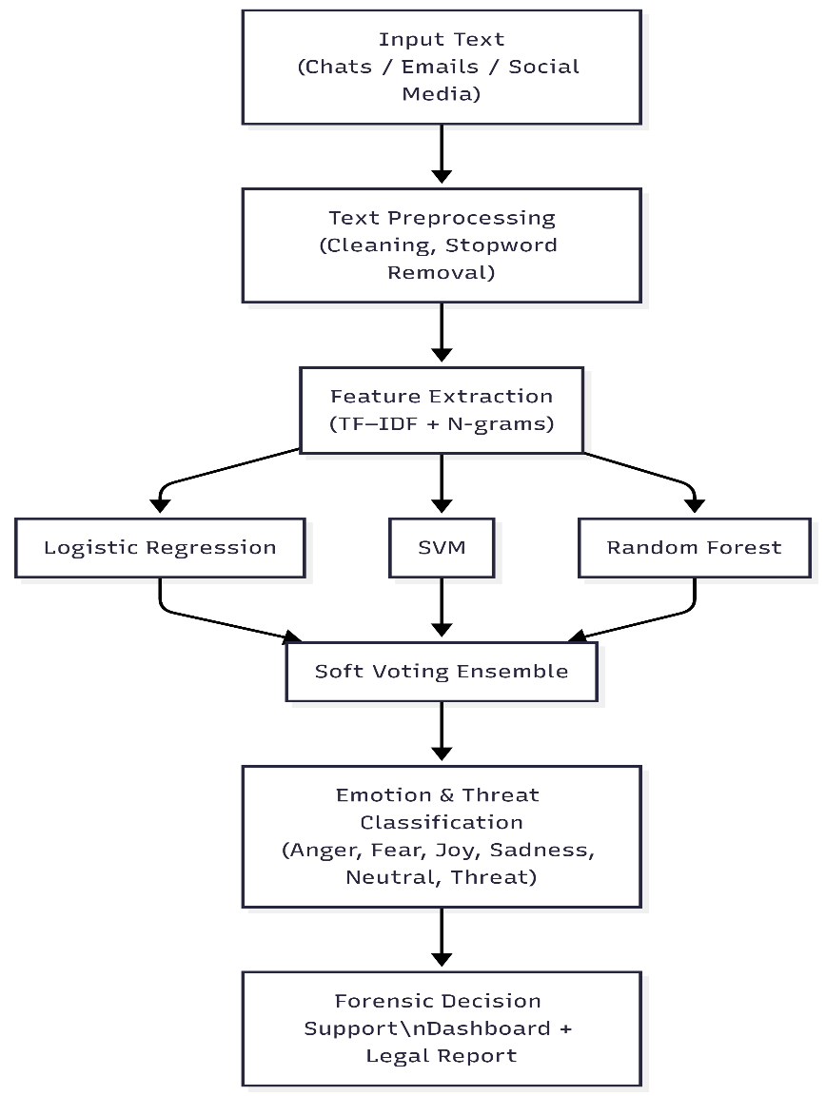
Flow Diagram of project work

Slide 6
methodology / approach
Data Collection:-Text-based datasets related to emotions and online threats were collected from open-source sources for training and testing the system.
Text Preprocessing:- The raw text data was cleaned using NLP techniques such as: Lowercase conversion, URL removal, Punctuation removal, Stopword removal, Noise reduction
Feature Extraction:- TF-IDF (Term Frequency–Inverse Document Frequency) was applied to convert textual communication into numerical feature vectors for machine learning models.
Machine Learning Models:- Three machine learning algorithms were implemented: Logistic Regression (LR) , Random Forest (RF) , Support Vector Machine (SVM)
Soft Voting Ensemble:- The predictions from all three models were combined using a Soft Voting Ensemble approach.The final emotion class was selected based on the highest average probability score.

Slide 7
Research Paper status
Submitted at:- Amity 2nd Research Conclave in 2026

Slide 8

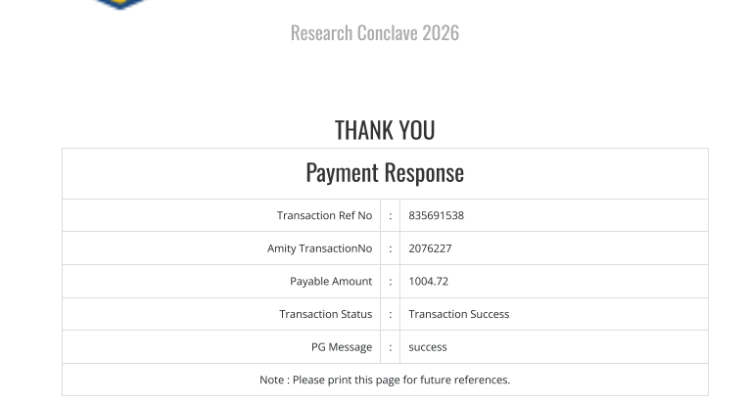
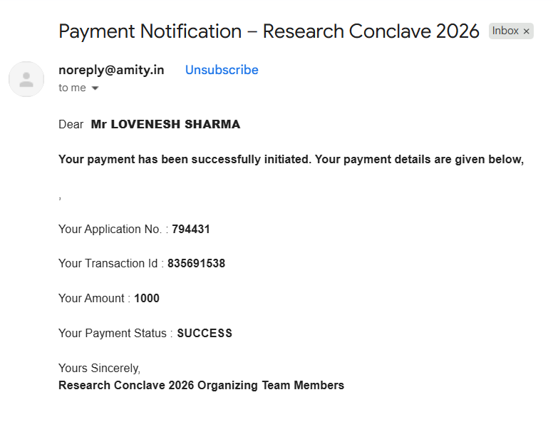

Slide 9
Thank you

